Slide 1


Revenue Insights Dashboard Industry :-- Hospitality
Naveen Kumar Adapala

Slide 2
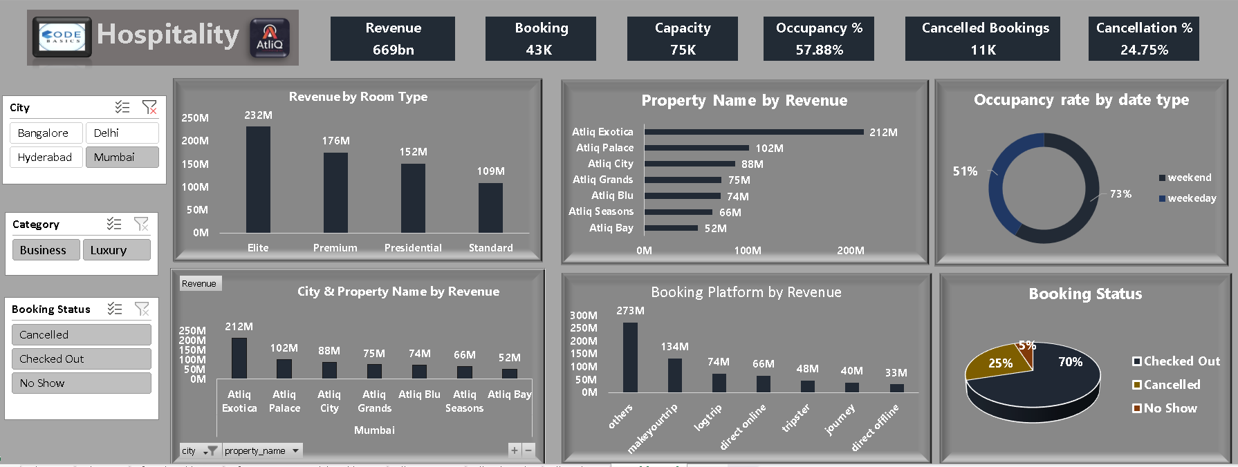
Revenue Insights
Notes:
textbox
No alt text provided
image
No alt text provided
image
No alt text provided
card
No alt text provided
card
No alt text provided
card
No alt text provided
card
No alt text provided
card
No alt text provided
shape
No alt text provided
shape
No alt text provided
slicer
No alt text provided
shape
No alt text provided
slicer
No alt text provided
Revenue by Property Name
No alt text provided
pivotTable
No alt text provided
Revenue by Room Type
No alt text provided
shape
No alt text provided
Revenue by Booking Platform
No alt text provided
Revenue by Room Type
No alt text provided
shape
No alt text provided
shape
No alt text provided
shape
No alt text provided
shape
No alt text provided
shape
No alt text provided
shape
No alt text provided
shape
No alt text provided
shape
No alt text provided

Slide 3
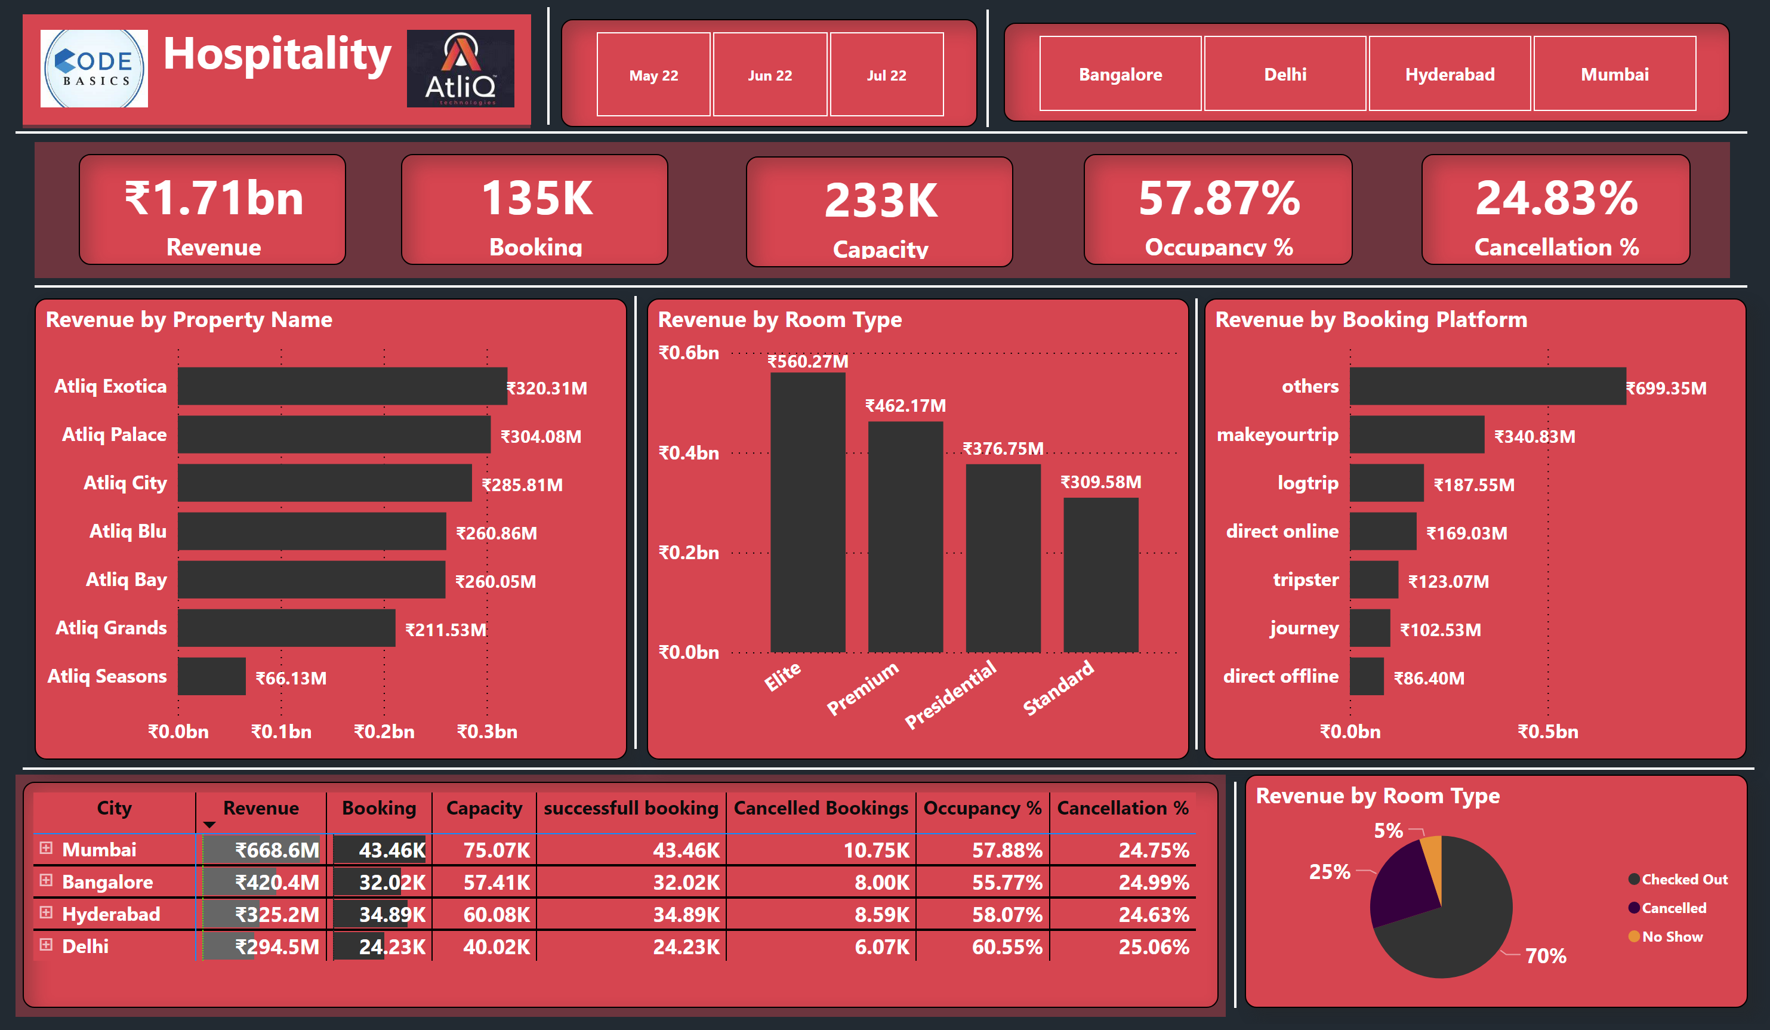
Revenue Insights
Notes:
textbox
No alt text provided
image
No alt text provided
image
No alt text provided
card
No alt text provided
card
No alt text provided
card
No alt text provided
card
No alt text provided
card
No alt text provided
shape
No alt text provided
shape
No alt text provided
slicer
No alt text provided
shape
No alt text provided
slicer
No alt text provided
Revenue by Property Name
No alt text provided
pivotTable
No alt text provided
Revenue by Room Type
No alt text provided
shape
No alt text provided
Revenue by Booking Platform
No alt text provided
Revenue by Room Type
No alt text provided
shape
No alt text provided
shape
No alt text provided
shape
No alt text provided
shape
No alt text provided
shape
No alt text provided
shape
No alt text provided
shape
No alt text provided
shape
No alt text provided

